Slide 1
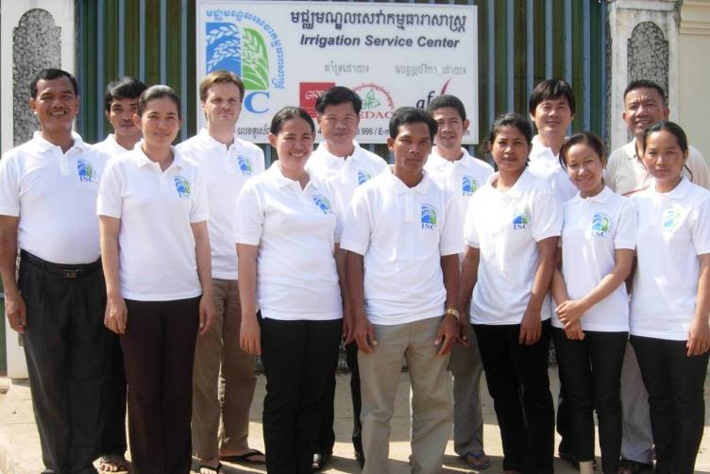
Welcome in Kompong Thom!

Slide 2
Irrigation Service Centre Project
Coordination meeting
24 August 2010

Slide 3
Coordination meeting program
Part I: Presentation of the ASIrri project and the ISC team
Part II: Intervention methodology
Part III: Results [July 2009 to June 2010]
Part IV: Challenges

Slide 4
Irrigation Service Centre Project Part I: Project presentation
Coordination meeting
24 August 2010
Antoine Deligne, Long Piseth
GRET ISC Project Coordinator

Slide 5
Cambodia irrigation sector
Legal framework (Circular No.1, Prakas 306)
~ 2500 infrastructures recorded
~ 500 schemes recorded in CISIS database
~ 300 FWUC registered by government
A large variety of systems (polders, reservoirs, pumping, protection dams, prek, etc.)
Many rehabilitations and large investments going on
But the O&M of newly rehabilitated schemes is not following the same dynamic

Slide 6
Functions of FWUC
The Operation and Maintenance of irrigation schemes require FWUC to undertake the following general functions:
System operation
Water management and sharing (setting up rules)
Maintenance of infrastructures
Irrigation Service Fee collection
Financial management
Institutional management (decision making, election, communication with members,...)
External relations with other stakeholders (LA, MoWRaM)

Slide 7
Skills needed to manage FWUC
The proper implementation of these major functions requires a large variety of skills, such as:
Engineering, design, preparation of bidding documents, topographic survey, etc.
Accounting, financial auditing, etc.
Information database management
Legal advise
Contacting government, organizing meeting with local authorities
Depending on FWUC size and budget, not all of these functions can be ensured by farmers or internalized with professional staff, but where to find support?

Slide 8
Why Service Centre?
A need: what happen when project support end?
FWUC need external technical support from outside organization on the long run
But no external organization is able to answer their practical needs at reasonable cost
There is a need to built up knowledge and capacities and sustain human resources on the long run
A tool: make farmers become decision makers
Services focus on demand
Service requires payment and suppose some kind of economical return

Slide 9
ASIrri Project
“Projet d’Appui aux Irrigants et aux Services pour les Irrigants Cambodge – Haïti – Mali (ASIrri)”
Partnership between 3 organizations:
IRAM (Mali) – AVSF (Haiti) – GRET (Cambodia)
January 2009 - December 2011
(Activities started in July 2009)
Cambodian component of ASIrri Project
AFD funding – 375 K€ for Cambodia
GRET - CEDAC partnership

Slide 10
EU Food Facility
Irrigation component of the action named « Development of food production, farming incomes, nutrition and resilience in rural Cambodia »
(GRET – AVSF – ADG – CEDAC)
January 2010 – June 2011
EU funding – 266 K€ [including 67 K€ co-funding from AFD]
GRET - CEDAC partnership
Result 2 – “More than 3,000 farmers’ families benefit from better access to water for agricultural use, and secure or diversify their production.”
3 provinces: Siem Reap, Kg Thom, Kg Cham

Slide 11
Basic project hypothesis
Existing FWUC need access to higher technical skills from outside service providers
FWUC & farmers are demanding these services and ready to pay for them.
GRET - CEDAC have the technical and organizational capacities to provide these services thanks to human resources from previous projects.
Are these hypothesis true?
‘Service Centre’: is it a good idea?
Feasible in Cambodia?

Slide 12
ASIrri Project Objectives
Establish one Service Centre in Kompong Thom
Develop and test services adapted to FWUC
Build up references and capitalize
Provide references to a national platform (advocacy)

Slide 13
Project organizational chart
IRAM - AVSF - GRET Project Steering Committee in Paris
AFD, EU
Other donors
MOWRAM (TSC / FWUC departments)
PDWORAM
Local authorities (Province / District / Commune)
GRET – CEDAC Management Committee
3 Advisors – 2 Coordinator
Service Centre Team (11)
O&M Technical expert and coordinator
Institutional expert
Administrative assistant
Hydraulic Engineer
GIS & Database manager
Community trainer
Community Facilitators (5)
Other partners
FWUC Network
FWUC
FWUC
FWUC

Slide 14
Team organizational chart
ISC coordinator
Contract negotiation and follow-up
O&M technical services team
Institutional services team
Financial management services team
Administrative management
Technical Assistant
Project Coordinator

Slide 15
The ISC team

