Slide 1
Irrigation Service Centre Project Part II: Intervention methodology
Coordination meeting
24 August 2010
A. Deligne, S. Sophak

Slide 2
Project process
Short assessment & pre-selection
Detailed study and mapping
Intervention strategy design
Study & strategy presentation
Formal service proposal
PDoWRaM & authorities approval
Contract agreement
Service implementation
Process follow-up
Service evaluation by farmers
Contract payment
Investment phase

Slide 3
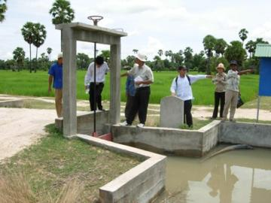
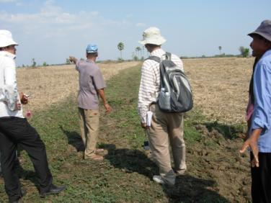
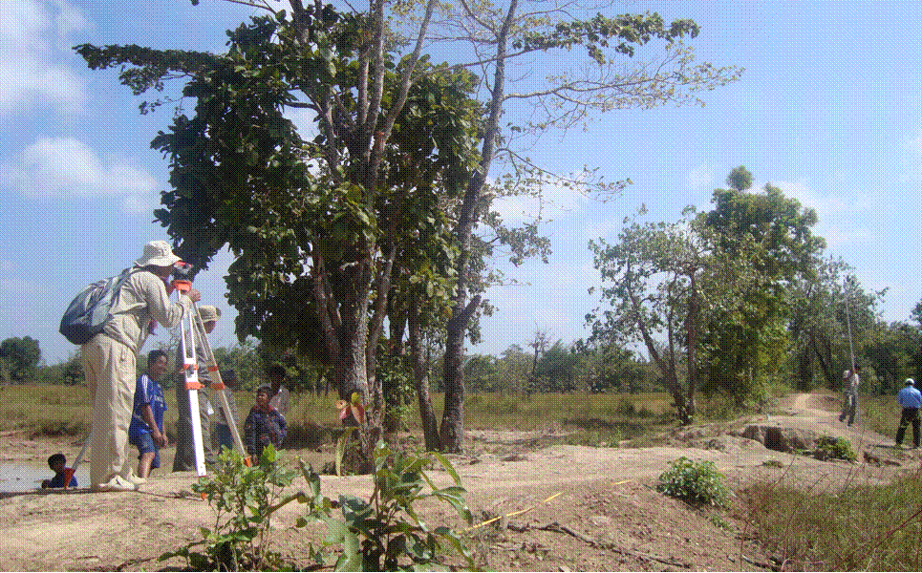
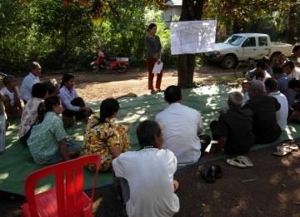
Scheme assessment

Slide 4
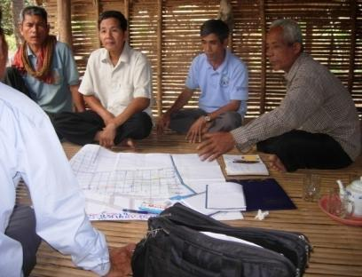
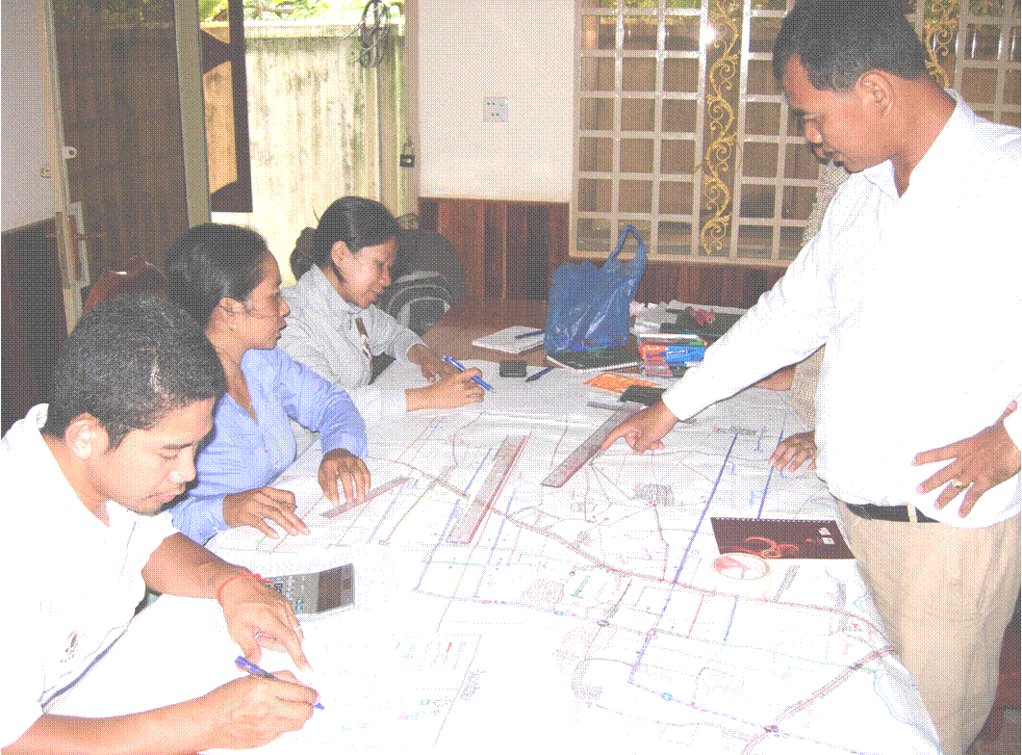
Interactive mapping

Slide 5
Scheme selection criteria
Within the targeted provinces
Partially functional infrastructures & reliable water source
Existing FWUC or farmer organisation in charge
Demand from farmers and/or local authorities
Sufficient agricultural and economic potential
No serious conflict
Support from local authorities (including financial)
Good potential for improvement
Financial means to pay services
The weight given to these criteria rests upon the team according to opportunities.

Slide 6
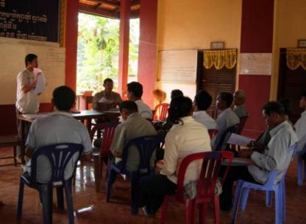
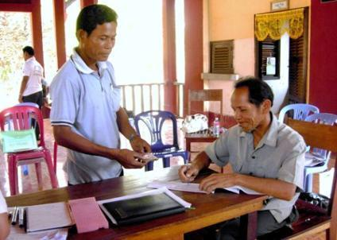
FWUC institutional support
Contract negotiation
Statutes elaboration
Membership registration

Slide 7
Client types and service categories
Different clients:
FWUC and FO
Communes and provincial NCDD team
Private agencies involved in FWUC support
Service categories
Creating - re-activating new FWUC/G
Capacity building to FWUC
Direct implementation by ISC under FWUC contract
FWUC support in contract with other agencies
Training to staff of other agencies

Slide 8
Service pricing
Service prices are calculated according to salaries, ISC functioning costs and number of working days sold, all costs included except transportation.
Subsidized Price for FWUC (15 to 30% real costs):
Advisor / expert: 20 US$ / day
Engineer / manager: 12 US$ / day
Facilitator: 8 US$ / day
Funding price for agencies (125 to 150% real costs):
Advisor / expert: 150 US$ / day
Engineer / manager: 80 US$ / day
Facilitator: 40 US$ / day
Supplementary subsidizing according to contract negotiation and FWUC resources availability

