Slide 1
Irrigation Service Centre Project Part III: Results (Presentation per scheme)
Coordination meeting
24 August 2010
L. Piseth, S. Sophak

Slide 2
ISC working area in 2010
Baray
Stung Chinit East & North
Machu Nga
Pram Kumpheak
Teuk Chha
Sdao Kong
Prey Nup

Slide 3
Pram Kumpheak irrigation scheme
5KPK
Location: Kampong Cham province, Chamkar Leu district, Lvea Leu and Svay Tiep communes
System: small reservoirs + gravity canals (I+II) built by KR and rehabilitated in 2000 by MoWRaM
Command area: over 1,000 ha
FWUC creation: in 2003 by MOWRAM on 2 communes
Management level: II (= FWUC existing, gate operation, no maintenance, no ISF)
Interest: Early wet season cropping, fertile soils, commune investment in canal construction

Slide 4
Map of Pram Kumpheak (Lvea Leu commune only)
5KPK
FWUG 2
231 ha
Phum Bey Reservoir
Rehabilitated structures
FWUG 1
261 ha
Kbal Hong Chas Reservoir

Slide 5
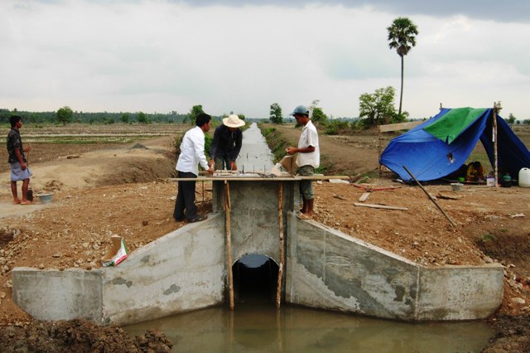
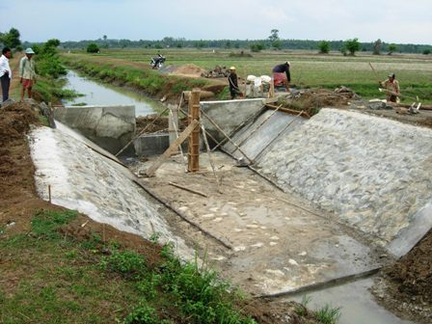
New Structures
5KPK

Slide 6
1st contract: reactivate FWUC
5KPK
Contract signed with Lvea Leu commune and FWUC in October 2009 for:
Creating 2 FWUG
Membership registration: 497 out of 559 landowners
MF collected = 7,445,000 riels (~ 1800$)
MF collection rate = 78-91%
Ballot election of 6 village representatives to form the FWUG committee
First general assembly
Contract completed in March 2010 and service fee paid (2 FWUG x 1,500,000 riels / FWUG)

Slide 7
2^{d} contract: database & rehabilitation
5KPK
Contract signed with Lvea Leu commune and FWUC in April 2010 for 8,000,000 riels:
Database creation, GIS mapping of every plot
Rehabilitation of 4 structures
Support for design, bidding and contracting
Engineer follow-up
Funding by AFD-EU = 23,200 US$
[Commune future funding = 60,000,000 riels]
Construction finished (some improvements needed)
Detailed plot database under work

Slide 8
... Next step!
5KPK
3^{d} service contract to be negotiated next year for:
Annual budget and ISF collection procedure
ISF collection
Financial management
Operation and water management follow-up

Slide 9
Teuk Chha irrigation scheme
TKC
Location: Prey Chhor district, Kompong Cham Province
2 communes , 24 village concerned
Type of system: Reservoir and gravity canals (I+II+III)
Construction: 1952-57 (1st reservoir), ‘70 (2^{d} reservoir)
Rehabilitation: 1995-97 (ADB) , 2003 (PRASAC)
FWUC creation: 1999 with PRASAC support
WS suppl. irrigated area (ha) ~ 4200 ha
~ 4400 landowners
DS and Early WS irrigated area (ha) ~ 690 ha
Rate of functioning ~ 50%, Level of management: II -> I

Slide 10
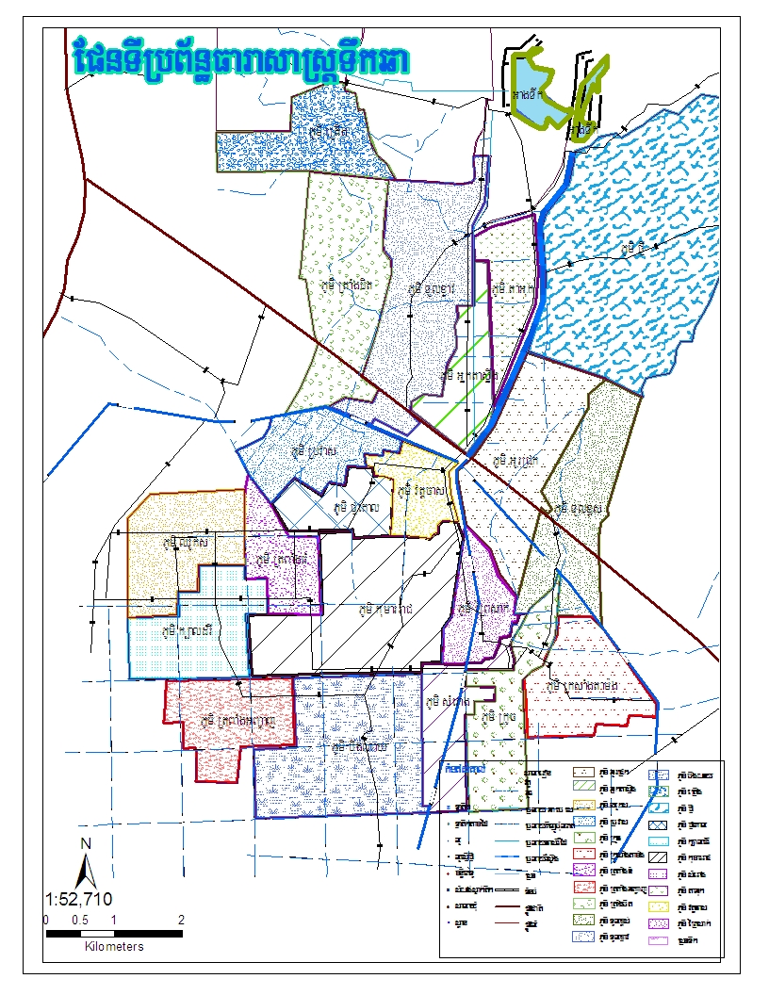
Teuk Chha Reservoir
TKC
Thmor Da Reservoir
Canal C
Main Canal
Canal A
Canal B
FWUG Canal B
~ 1600 ha

Slide 11
2 service contracts
TKC
2 contracts signed with FWUC and communes in May 2010 for:
Creating a FWUG at secondary canal B
Organizing water sharing and supply along main canal
Implementing a heavy maintenance on MC and SCB (budget estimate = 36,000$ from EU-FF)
Contract amount = 7,400,000 KHR shared by commune (2x3 millions) and new FWUG (1.4 million)
Implementation period: May - December 2010

Slide 12
Canal B FWUG creation
TKC
Membership registration: 571 / 725 landowners
Rate of MF payment: 79%
Total amount collected = 8,560,000 KHR
Election planned
Canal and structures heavy maintenance planned

Slide 13
Main canal management
TKC
Creation of an advisory committee to take decisions on water management rules (PDoWRaM, commune chiefs, village chiefs, ISC staff)
FWUC recruited 4 gate operators with commune and ISC funding
Gates are locked, irrigation is provided upon formal request, rules are set up to prioritize requests
Test water distribution and duration
Create a “Reservoir Management Committee”(?)
Canal and structures heavy maintenance planned

Slide 14
Stung Chinit East
SCE
Location: Kompong Thom province, Santuk district, Kompong Thmor Commune
Objective: build a canal-drain to irrigate max. 450 ha by using an existing gate from Stung Chinit reservoir
Budget estimate: ~50,000 USD (~125 USD/ha)
Initial funding:
Commune of Kompong Thmor by using Commune Development Fund (~15,000 USD)
Possible supplementary funding from ASIrri (EU-FF) ~20,000 USD
Others?

Slide 15
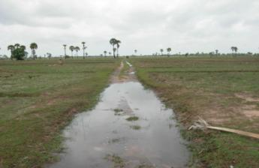
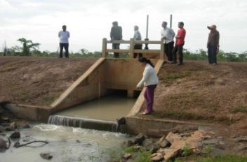
SCE
Stung Chinit North main canal
Stung Chinit East canal project
Canal
Gate
Stung Chinit Reservoir

Slide 16
1st Service contract
SCE
Contract signed with Kg Thmor commune for:
Creating a FWUG at La-ak village
Consulting with land owners and studying the future canal alignment
Negotiating design with NCDD engineers
Contract amount = 8,400,000 KHR (6,9 millions paid by commune, 1,5 million paid by FWUG)
Implementation period: May - September 2010

Slide 17
Implementation results
SCE
221 / 289 landowners (76%) paid the membership fee
Total amount collected = 5,365,000 KHR
Decision on alignment to be finalized soon according to the final design
Land compensation still need to be discussed
2d service contract for work follow-up to be negotiated

Slide 18
Stung Chinit North irrigation scheme
SCN
Location: Santuk district, Kampong Thom province, 3 communes concerned
System: River reservoir with diversion to gravity canals (I+II+III) and independent drainage
Scheme size: 2,400 ha
Construction: Under Pol Pot regime
Rehabilitation: 2001-07 by MoWRaM – ADB – AFD
FWUC creation: 2002 by GRET/CEDAC
FWUC members: 2828 farmers
ISF collection rate in 2010: 87%, ISF = 30,000 riels/ha
No membership fee

Slide 19
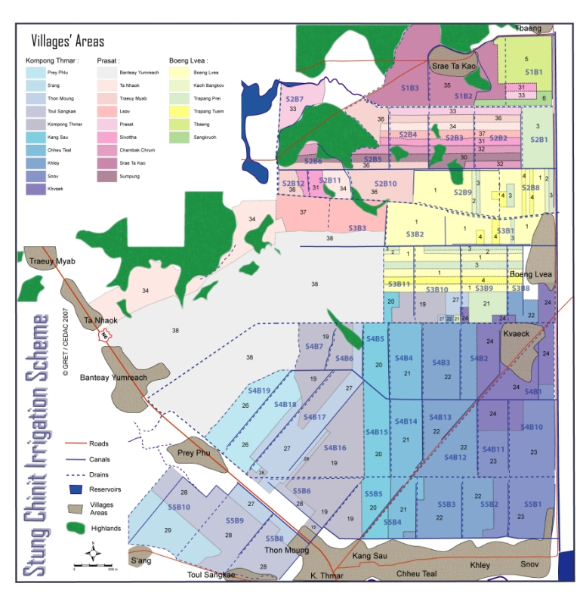
Stung Chinit North scheme
SC1
SC2
Project to build canal and extend irrigated area
SC3
SC4
SC5
Reservoir

Slide 20
1st Contract & other supports
SCN
Contract signed between FWUC committee and ISC in December 2009
Service price: 260 USD (paid in April 2010)
Services:
Updating land owner database
Following up ISF collection results
Maintenance plan preparation
Financial reporting and budget preparation
Facilitating CRIC meeting
Outside contract, ISC provided support for:
Negotiating responsibility sharing agreement (LoA) between FWUC and PDoWRaM (signed on 6 October 2009)
Requesting a functioning subsidy to MoWRaM and AFD (29,137 USD approved in June 2010)

Slide 21
…Next step!
SCN
2d & 3d service contracts under negotiation:
a yearly contract for regular support based on FWUC demands (database, financial follow-up, etc.)
one contract for specific services:
Assessment for irrigated area extension and cost estimation,
Writing proposal
Looking for funds

Slide 22
Sdaov Kong irrigation scheme
SDK
Location: Baphom district, Prey Veng province
System: Pumping station and gravity canals (I+II)
Serviced area: 300 ha (functioning: 100-130 ha)
Rehabilitation: 2004 by MoWRaM and French Embassy
FWUC creation: 2004 with CEDAC support
Management level: III (FWUC existing, pump operation, ISF collection, no canal maintenance)
ISF level: 200,000 KHR / ha (50% if suppl. pumping)
Interest: Receding and EWS cropping, fertile soils, FWUC autonomous since 2005.

Slide 23
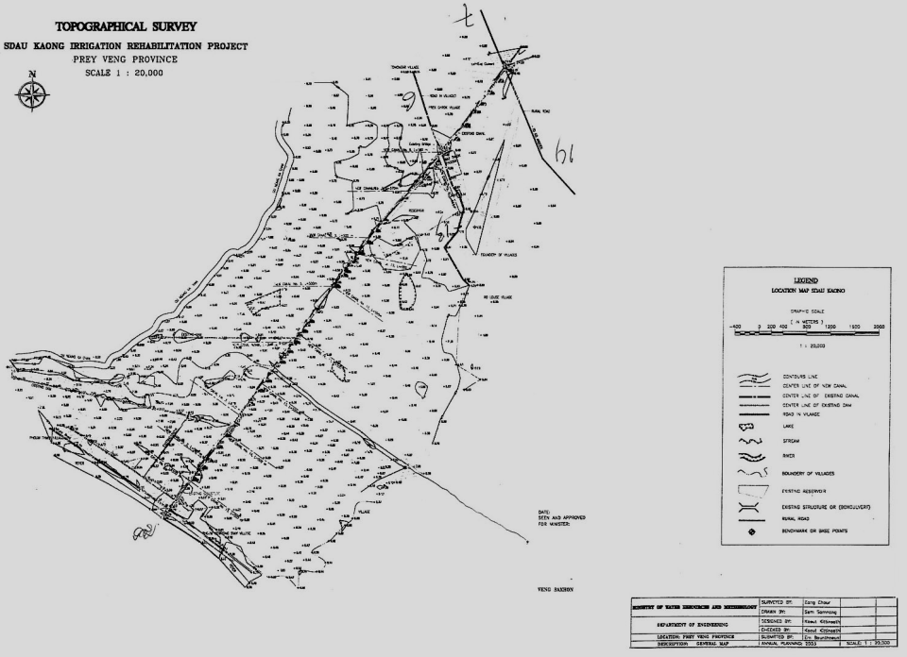
Sdaov Kong map
SDK

Slide 24
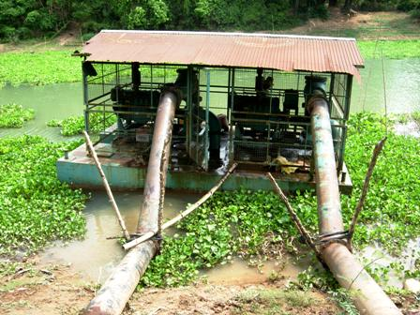
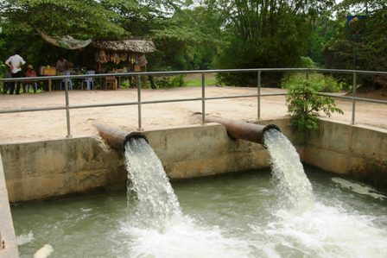
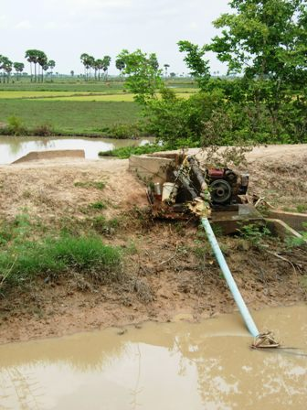
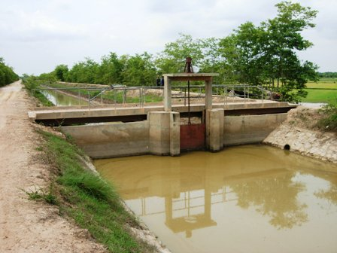
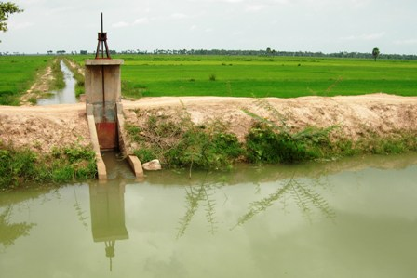
Pumping Station
Main to secondary canal by gravity
Main canal
Supplementary pumping to secondary canal

Slide 25
Support provided (no contract)
SDK
Financial review and assessment since 2005
Financial report writing
Future budget design and plan
Functioning subsidy request to MoWRaM and AFD
6,300 USD subsidy approved in June 2010
This budget includes future service costs and maintenance

Slide 26
… Next step!
SDK
Contract negotiation between FWUC and ISC:
Contract 1: one year contract for financial follow-up and other needs based on FWUC demands
Contract 2: specific service contract for maintenance:
Canal maintenance assessment and cost estimation
Proposal writing
Construction follow-up
Budget allocation from EU-FF = ~25,000 USD

Slide 27
Machu Nga irrigation scheme
MNG
Location: Koah Nhek district, Mondulkiri province, Royor commune
System: Reservoir and gravity canals (I+II)
Construction: 2010 funded by Excom Mundolkiri, JICA
Command area ~ 150 ha
No existing FWUC, but demand from Excom Mondulkiri (funded by JICA) to support FWUC creation
Contract signed with CEDAC in April 2010 for 25,000$
Second contract signed with commune for 241$

Slide 28
Service implementation
MNG
Services:
Create a FWUC: farmer mobilization, MF collection, registration at provincial level
Capacity building for the FWUC committee about:
Construction follow up
O&M
Financial management
ISF collection
Results:
MF collection rate: 82%, Members: 33 / 40 landowners
FWUC registration?

