Slide 1
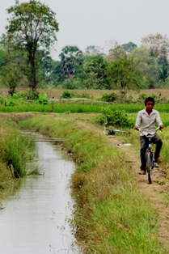
FWUC management evaluation methodology
based on a criteria method

Slide 2
What to evaluate?
The FWUC capacity to undertake their main tasks:
Operation
Maintenance
Communication and relationship with farmers and other stakeholders
Financial management / ISF collection
Sustainability
But only for schemes where infrastructures are operational, water is available at plot level and conflicts between users are manageable.

Slide 3
Why to evaluate FWUC management?
Identify practical problems faced by committee
Teach FWUC committee about what they are supposed to do or to achieve
Control that the FWUC is doing what it is suppose to do
Define priorities for improvement
Identify needs in term of external support
Compare FWUC together in a sector approach

Slide 4
How to evaluate?
Participatory process: local stakeholders evaluate themselves
Based on pre-defined criteria, so they can be compared
Support team ask detail questions for people to think about what they do or not, what they can do or not
5 levels / criteria: 3 levels successful and 2 level not successful
Two sub-groups contradict each other
Farmers and village chief
FWUC committee, Commune chiefs & Pdowram
Compare point of views from different stakeholders
Classification in categories to compare FWUC and for summary purpose
Arrow presentation to facilitate global review by farmers
Excellent
Good
OK but to improve
Very weak
Non existent

Slide 5
Procedure
Duration: from 3 to 6 hours
3h for FWUC with limited activities
6h for FWUC with high level financial management
Participants (10-15 people)
FWUC committee members (3-5)
Commune chiefs (1-3)
Village chiefs (3-4)
Farmers (1-3)
PDOWRAM staff in charge (0-1)
Facilitators (2-4)
1 ISC staff
1 MOWRAM - FWUC Department staff
1 Farmer & Water Net representative
1 project staff if any project supports the FWUC

Slide 6
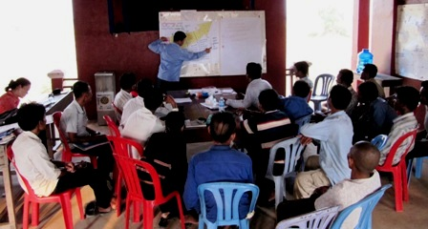
Procedure
Step 1: Presentation of the evaluation objectives and process
Step 2: 2-3 sub-groups discussion (~5 people / group): review 33 criteria
Step 3: Discuss each criteria position in plenary session and draw the arrow
Step 4: Presentation of results, FWUC category and discussion on priority for improvement

Slide 7
33 criteria
Sustaina-bility
Financial management
ISF collection
Maintenance
MoU
Operation
Membership & database
Institutional building (election, GA)
Water control & economic performance
Farmer organization
Local authorities support

Slide 8
Criteria for institutional organization

Slide 9
Criteria for ISF collection

Slide 10
Arrow representation

Slide 11
6 FWUC categories (0 – V)
Category | Description
0= Not operational | Irrigation is not (yet) available: scheme under construction or too damaged or not sufficient water resource available
I = Partially operational | Irrigation is at least partially available and there is some farmer management, but very low performance, no clear organization between farmers, or less than one year experienced.
II = Institutional construction | The scheme is managed by an active FWUC with clear membership and an elected committee, but management level is weak: the FWUC can ensure only the basic scheme operation.
III = Basic management | The FWUC operates the scheme and implements some emergency maintenance. The FWUC try to collect ISF, but the amount and the percentage collected are low. The FWUC organizes yearly village or general assemblies.
IV = Experienced management | The FWUC is experienced and collects ISF at a good level; it has a budget and a good financial management. It ensures a regular maintenance, but still insufficient on the long term.
V = Expert management | The FWUC is financially and technically autonomous and sustainable. Financial control systems are in place. Maintenance is sustainable over the long term. The FWUC has signed a responsibility sharing agreement (MoU) with MOWRAM.

Slide 12
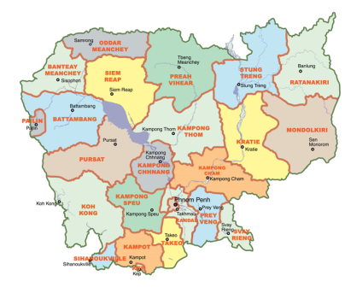
Results for FWN
V: Prey Nup
IV: Stung Chinit
III: Sdao Kong, O Treng,
O Veng, Ta Roat
II: Ponley, Po Pi Daem,
Kok Thnaot
I: Baray, Trov Kord,
Teuk Chha, Pram Kumpheak

Slide 13
Discussion on priorities for improvement
Water availability?
Infrastruc-tures?
Farmer participation & investment?
Institutional model?
Election?
Communication?
Technical capacity?
Commune support?
Financial manage-ment?
Database?
Support from MOWRAM?
ISF collection?

Slide 14
Some limits of this evaluation method
Based on the understanding and experience of local stakeholders (may hamper comparison with other FWUC)
Not adapted for FWUC with limited or no activity, where there is only “infrastructures”
Not all criteria are relevant for small FWUC based on farmers’ participation only, without formal organization.
No criteria on popular issues for development agencies such as gender, environment (in order to keep it focused on the main practical problems)
Not all issues are considered: it should not replace a full detailed evaluation -> not adapted for “feasibility studies”

